Slide 1
Face Recognition Using SVM

Slide 2
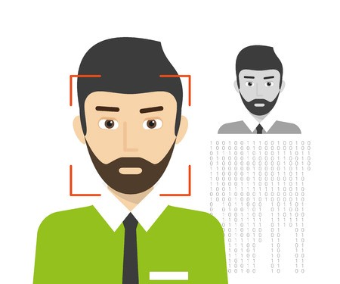
Objectives
Face recognition on The Database of Faces at a glance.
Data pre-processing.
Dimension reduction using PCA.
Support Vector Machines (For classification)

Slide 3
Project work flow
Data
Results without PCA
Visualization
SVM
Analysis
PCA
Results with PCA

Slide 4
Data-Set The Database of Faces at a Glance
The data-set consists of 400 pictures of 40 people.
Each picture has a dimension of 112X92 pixels.
Data set comprises of pgm format.

Slide 5
Data pre-processing
Each image is flattened into row vector of size 10304.
The size of whole data set becomes 400X10304.
Then converted into a numpy ndarray.

Slide 6

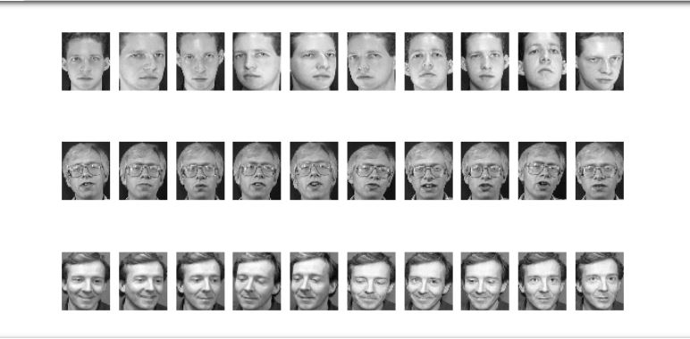
Sample of data set
Front faced pictures of a single subject was captured in different perspective & can be seen by plotting few examples of the given data-set.

Slide 7
Dimension reduction using PCA
Redundant features are removed using PCA.
Eigen vectors with more variance are kept while with low variance are discarded.
Output matrix from PCA will look noting like original image.

Slide 8
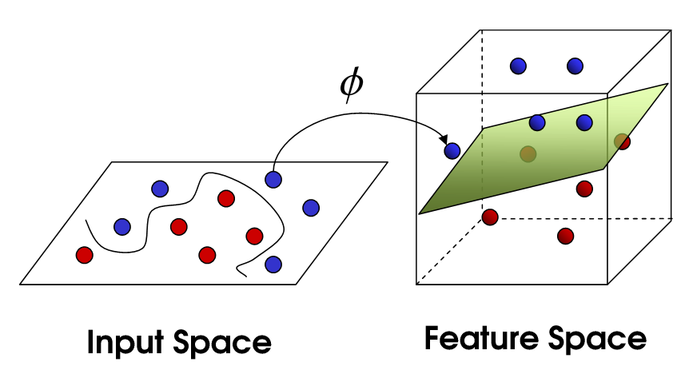
Support Vector Machine (SVM)
First of all for classification SVM is applied directly without using SVM.
To get maximum margin, Linear classifier was used.
100% accuracy was achieved.

Slide 9
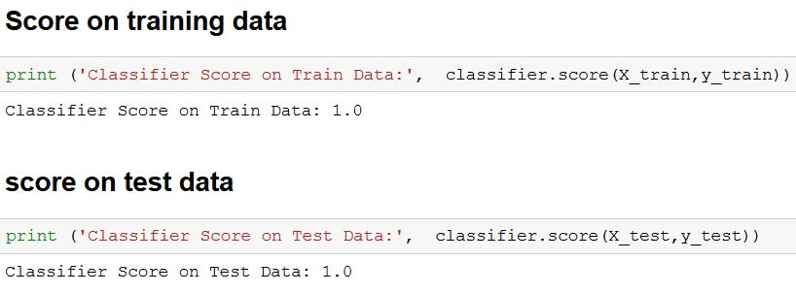
Score without using PCA
When original numbers are used that is dimension reduction isn’t performed we have maximum score

Slide 10
SVM after using PCA
PCA was implemented for K=1,2……10
For K=1 , error was 94%.
For K=10, error was 1%.
Significant improvements made when dimensions were increased.

Slide 11
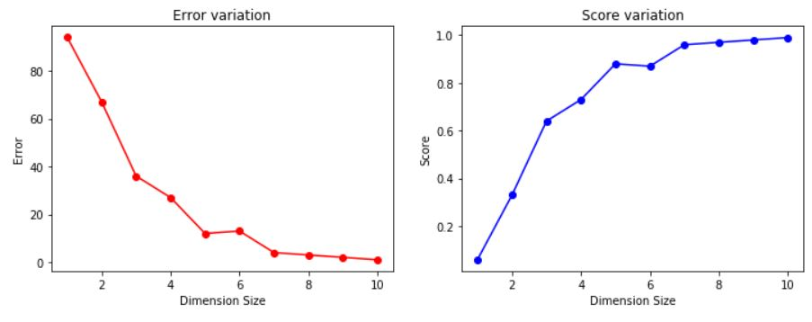
Results with PCA
As we are increasing number of dimensions error is decreasing and score is increasing to one.

